Slide 1
Understanding the Court Process in Child Welfare & Minor Guardianship Cases: Rights, Roles, and Requirements Families Like Mine Conference – June 3, 2023
Bridget Mauerman, CCIP Director
Kristen Wetzel, CCIP Legal Advisor

Slide 2
Please note that the information contained in this presentation is not meant to be construed as legal advice.
Any guidance provided should not override a judge’s decision and authority.
Questions are welcome; however, CCIP is unable to provide input on individual cases.
Thank you!

Slide 3
CCIP Overview
CCIP – Children’s Court Improvement Program
Since 1995, have received federal Court Improvement Program (CIP) funding to develop and implement recommendations to enhance the court's role in achieving stable, permanent homes for children in foster care
CIP is present in all 50 states, some U.S. territories, and a number of federally-recognized tribes
Wisconsin Supreme Court
Director of State Courts Office
CCIP

Slide 4
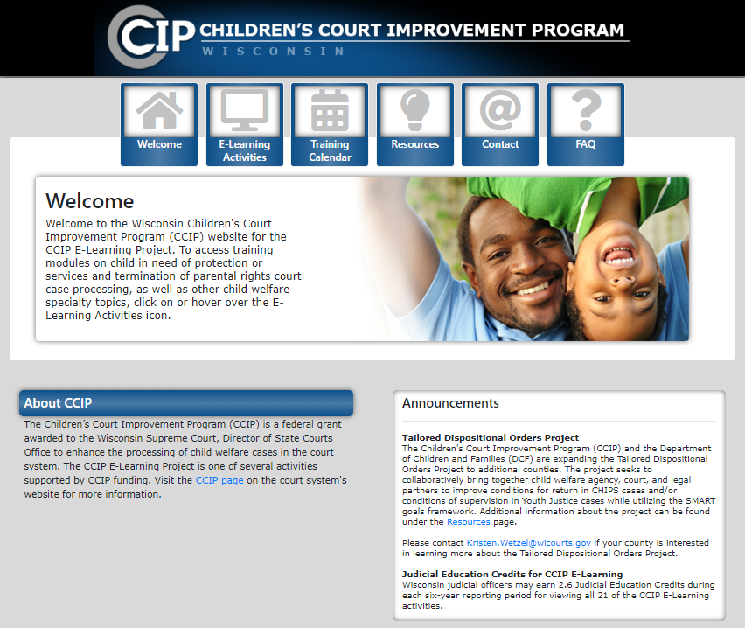

Slide 5
Circuit Court Forms www.wicourts.gov
Hover over Forms and select Circuit court
Select Juvenile

Slide 6
Juvenile Case Types
Child in Need of Protection or Services (CHIPS)
Unborn Child in Need of Protection or Services (UCHIPS)
Juvenile in Need of Protection or Service (JIPS)
Ex: truancy, runaway, uncontrollable, incompetent
Delinquency
Crime if committed by an adult (10-17 years old)
Termination of Parental Rights (TPR)
Voluntary or involuntary
Guardianship
Ch. 48 – minor guardianship of the person/child
Ch. 54 – minor guardianship of the estate
Other:
Adoption, Juvenile Injunction, Juvenile Mental Commitment, and Waiver of Parental Consent for Abortion

Slide 7
Wisconsin Statutes
Chapter 48
(Children’s Code)
CHIPS
TPR
Guardianship (person)
Adoption
Chapter 938
(Juvenile Justice Code)
Delinquency
JIPS

Slide 8
Child in Need of Protection or Services (CHIPS) Cases

Slide 9
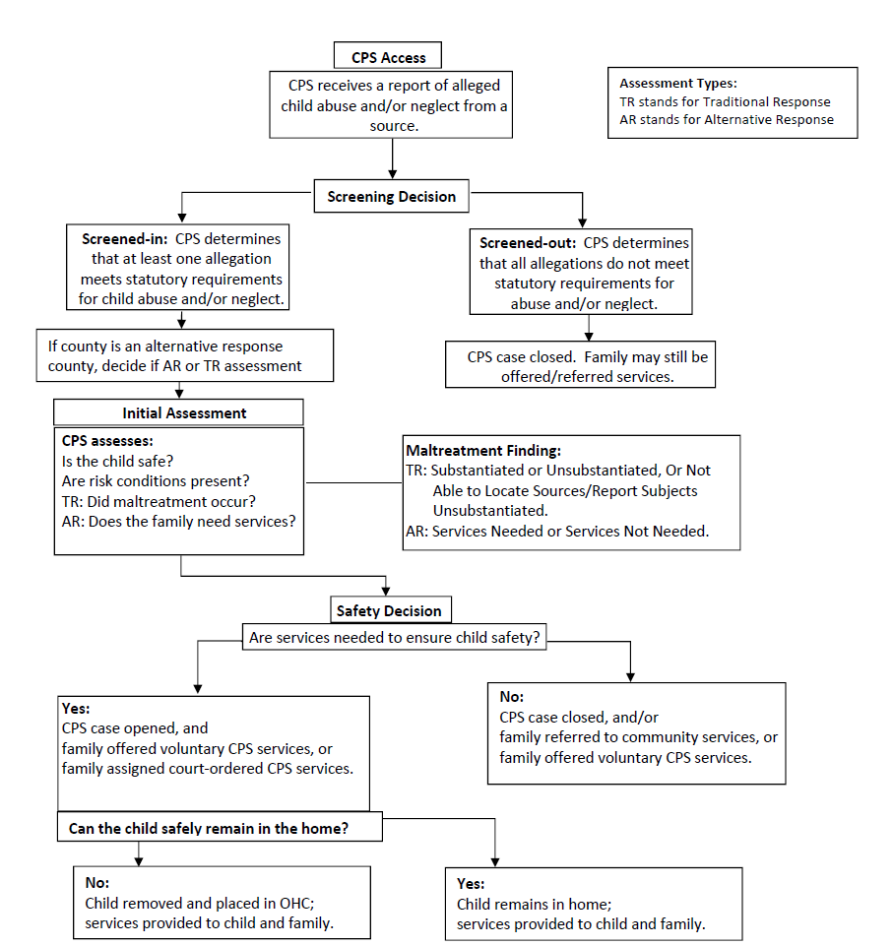
Overview of the Child Protective Services (CPS) Process

Slide 10
Out-of-Home Placements

Slide 11
Out-of-Home Placement
A child/juvenile is considered to be in an out-of-home placement for purposes of court findings and permanency planning when placed with anyone except a parent in a CHIPS, JIPS, or delinquency case
Exceptions for placements in secure detention under certain circumstances
See §§ 48.38(2) & 938.38(2)

Slide 12
Caregiver Definitions
Guardian – Person named by the court having the duty and authority of guardianship
Legal Custodian – Legal status created by the order of a court, which confers the right and duty to protect, training and discipline the child, and to provide food, shelter, legal services, education and ordinary medial and dental care, subject to the rights, duties and responsibilities of the guardian of the child and subject to any residual parental rights and responsibilities and the provision of any court order
Physical Custody – Actual custody of the person in the absence of a court order granting legal custody to the physical custodian
Note: Physical custodian is different than legal custodian

Slide 13
Caregiver Definitions
Relative – A parent, stepparent, brother, sister, stepbrother, stepsister, half brother, half sister, brother-in-law, sister-in-law, first cousin, 2nd cousin, nephew, niece, uncle, aunt, step-uncle, step-aunt, or any person of a preceding generation as denoted by the prefix of grand, great, or great-great, whether by blood, marriage, or legal adoption, or the spouse of any person named in this subsection, even if the marriage is terminated by death or divorce
For purposes of placement, “relative" also includes a parent of a sibling of the child who has legal custody of that sibling

Slide 14
How does a CHIPS case begin?
Temporary Physical Custody (TPC)
The child is removed from the home and a Temporary Physical Custody Hearing is scheduled
CHIPS Petition is filed requesting jurisdiction
The CHIPS petition can be filed at the same time as the TPC, up to 72 hours after the TPC hearing, or without a TPC for an in-home case

Slide 15
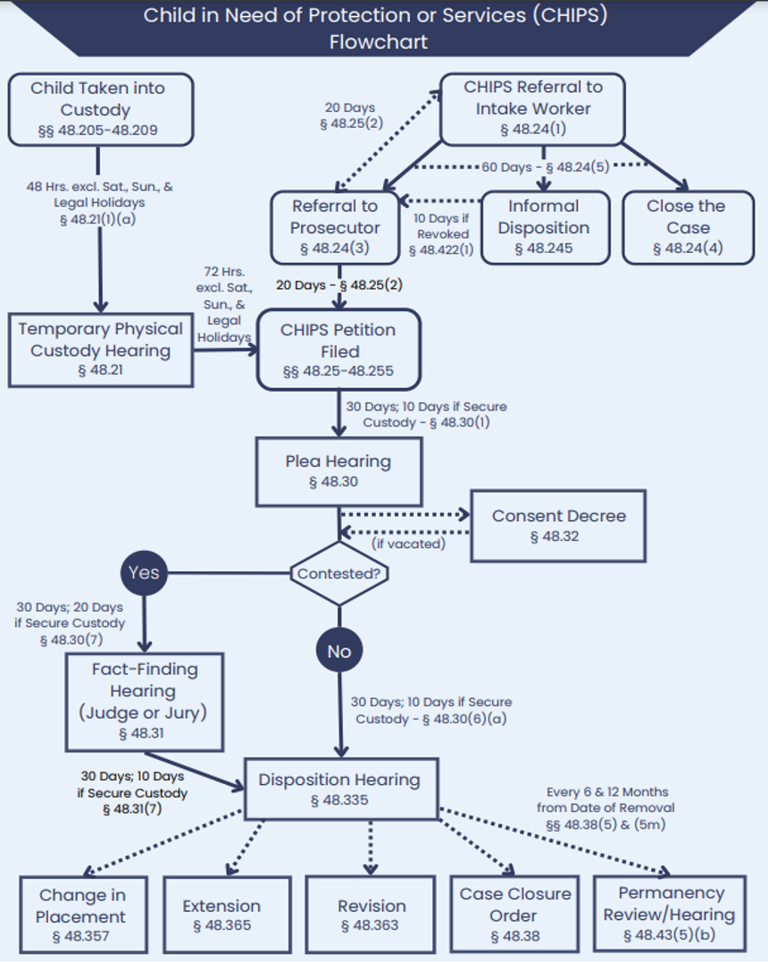

Slide 16
Temporary Physical Custody (TPC)

Slide 17
TPC Hearing
The TPC hearing must be held within 48 hours of removal for a CHIPS case and 24 hours for a Delinquency and JIPS cases
Time period excludes legal holidays and weekends
Burden is probable cause that one of the following exists:
Child will cause injury to self OR be subject to injury by others
Parent(s), guardian, legal custodian or other responsible adult is neglecting, refusing, unable, or unavailable to provide adequate supervision and care AND services to ensure the child's safety and well-being are not available or would be inadequate
Child will run away or be taken away, making the child unavailable for further court proceedings
Parent(s) has relinquished custody of the child
If proven, the court issues a temporary order regarding placement of the child
The CHIPS petition may be filed at the same time of the TPC hearing or within 72 hours after the TPC hearing

Slide 18
Petition to Disposition

Slide 19
Who can file a CHIPS petition?
Attorney representing interests of the public, §48.09
Corporation Counsel, District Attorney, or Contract Attorney
Counsel or GAL for parent, relative, guardian, or child
Parent or guardian, §48.13(4)
Unable or needs assistance to care for or provide necessary special treatment or care for child
Child who is 12 years or older, §48.13(9)
In need of special treatment or care with parent, guardian or legal custodian is unwilling, neglecting, unable or needs assistance to provide

Slide 20
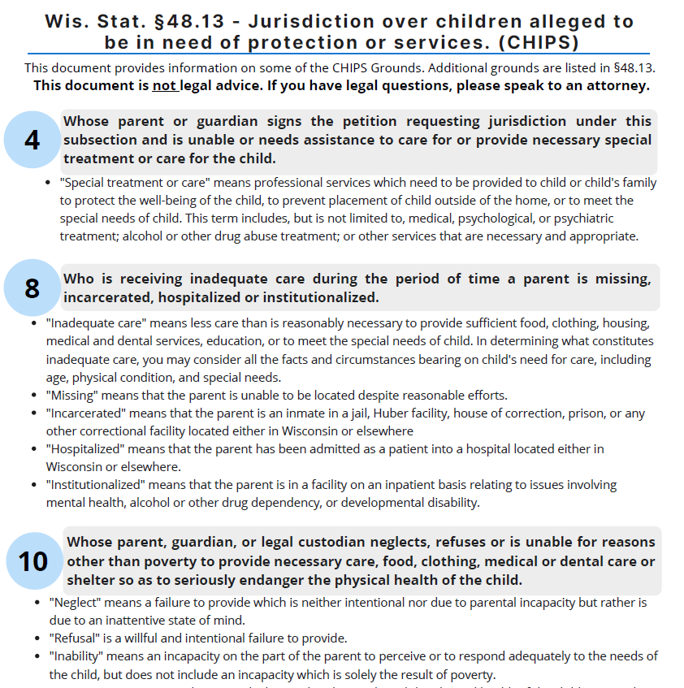
CHIPS GROUNDS

Slide 21
CHIPS Grounds/Allegations – §§ 48.13 (10) & (10m)
There are 16 CHIPS grounds alleging that a child is need of protection or services
The most frequently filed grounds are (10), (10m), (3), and (3m):
(10) The child's parent, guardian or legal custodian neglects, refuses or is unable for reasons other than poverty to provide necessary care, food, clothing, medical or dental care or shelter so as to seriously endanger the physical health of the child
(10m) The child's parent, guardian or legal custodian is at substantial risk of neglecting, refusing or being unable for reasons other than poverty to provide necessary care, food, clothing, medical or dental care or shelter so as to endanger seriously the physical health of the child, based on reliable and credible information that the child's parent, guardian or legal custodian has neglected, refused or been unable for reasons other than poverty to provide necessary care, food, clothing, medical or dental care or shelter so as to endanger seriously the physical health of another child in the home

Slide 22
CHIPS Grounds/Allegations – §§ 48.13 (3) & (3m)
(3) The child has been the victim of abuse, as defined in § 48.02 including injury that is self-inflicted or inflicted by another
(3m) The child is at substantial risk of becoming the victim of abuse, as defined in § 48.02, including injury that is self-inflicted or inflicted by another, based on reliable and credible information that another child in the home has been the victim of such abuse
Victim of abuse under § 48.02:
Physical injury other than accidental means
Sexual intercourse or sexual contact
Manufacturing methamphetamine:
With a child physically present during the manufacture;
In a child's home, on the premises of a child's home, or in a motor vehicle located on the premises of a child's home; or
Under any other circumstances in which a reasonable person should have known that the manufacture would be seen, smelled, or heard by a child

Slide 23
CHIPS Grounds/Allegations – § 48.13 (4)
(4) The child's parent or guardian signs the petition requesting jurisdiction under this subsection and is unable or needs assistance to care for or provide necessary special treatment or care for the child
"Special treatment or care" means professional services which need to be provided to the child or his/her family to protect the well-being of the child, to prevent placement of the child outside of the home, or to meet the special needs of the child. This term includes, but is not limited to, medical, psychological, or psychiatric treatment; alcohol or other drug abuse treatment; or other services that are necessary and appropriate.

Slide 24
Representation of Children
Guardian ad Litem (GAL)
Represents child’s best interests
In Wisconsin, must be an attorney
Functions independently
Requirements, unless granted leave by court, § 48.235:
Meet with the child
Assess appropriateness and safety of child’s environment
Interview child if old enough to communicate and determine child’s goals and concerns regarding placement
Make clear and specific recommendations to the court
Notify court if the best interests of the child are substantially inconsistent with the wishes of that person
Statement of Guardian ad Litem - JD-1799 (optional form)

Slide 25
Representation of Children – CHIPS Case
Adversary Counsel
Generally, appointed for children 12 years or older
May also have a Guardian ad Litem – it depends on the case
Represents child’s wishes.
“…shall advance and protect the legal rights of the party represented…”
Typically appointed through the State Public Defender’s Office.
Indigency determination is not required
Remember to refer children 12 years of age and older to SPD for appointment of counsel as soon as possible - §§ 48.23 (1m) & (3m)

Slide 26
Child Representation Chart – Ch. 48
GAL Required
Guardianships under Ch. 48
Adversary Counsel Required
Minor expectant mother of unborn child
CHIPS when grounds of abuse or neglect – Under 12 years old
CHIPS when out-of-home has been ordered, recommended, or requested – All ages
CHIPS when grounds of abuse or neglect – 12 years & older
CHIPS at hearing when out-of-home placement is ordered – 12 years & older
Chapter 51 & 55 proceedings
Unborn child (UCHIPS)
Contested adoptions
All TPR cases
Minor parent for voluntary TPR
Minor parent for involuntary TPR
See §§ 48.23 & 48.235

Slide 27
Representation of Parents
Parents have the right to hire their own attorney
Parents are only appointed an attorney through the State Public Defender’s Office if the parent is indigent and:
the county is participating in the 5 county SPD pilot, OR
Racine, Kenosha, Outagamie, Brown, and Winnebago
the case is subject to Wisconsin Indian Child Welfare Act
A parent can also request a court-appointed attorney
Discretion of the court after considering circumstances of parent/case
Parent may be required to reimburse the county
Court always has discretion to appoint a GAL (e.g., competency issues)

Slide 28
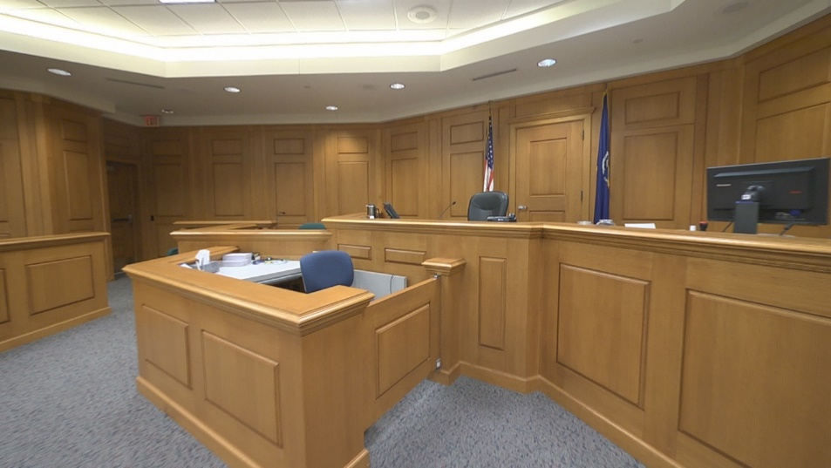
Plea Hearing
After the CHIPS petition is filed, the court will schedule a plea hearing within 30 days
The child, parents, guardian, legal custodian, and Indian custodian must be advised of their rights
Ex: substitute the judge, a jury trial, retain an attorney, etc.
Notice of Rights and Obligations – JD-1716 and IW-1716
*A jury trial demand or substitution request must be made before the end of the Plea Hearing

Slide 29
Plea Hearing
Pleas are taken from:
“Nonpetitioning parties”: parents, guardian, legal custodian, and Indian custodian
Child (if 12 years or older or otherwise competent to enter plea)
If admissions or no-contest pleas are entered, the child will be adjudicated a child in need of protection or services (CHIPS) and the case will be scheduled for a Dispositional Hearing within 30 days
If a party enters a denial, a Fact-Finding Hearing is scheduled within 30 days
Timeframes can be adjourned for good cause

Slide 30
Fact-Finding Hearing
Court/bench trial or a jury trial
The party that entered the denial has the right to either a court trial to the judge or a 6-person jury trial
A 5/6 verdict is required in a jury trial to find the child CHIPS
The trial is to determine whether the allegations in the CHIPS petition are proven by clear and convincing evidence.
If proven, the child is adjudicated CHIPS
If the burden is not met, the CHIPS case is dismissed

Slide 31
Dispositional Hearing
If the child is adjudicated to be CHIPS – Child in Need of Protection or Services, the case proceeds to a Dispositional Hearing
The court orders placement of the child
In-home
Conditions of Supervision should be ordered for both parents
Out-of-home
Conditions for Return are ordered for both parents
Termination of Parental Rights (TPR) warnings are read and attached to order
Order must also contain specific services that the agency will provide the family
Length of the order depends if the child is placed in-home or out-of-home

Slide 32
Expiration of Dispositional Order
Out-of-Home
Unless earlier time specified by court, the later of:
18th birthday
High school graduation/equivalent or 19th birthday
If full-time student and reasonably expected to complete the program prior to age 19
21st birthday
If IEP, full-time student, and youth agrees
In-Home
Up to 1 year
The order can be extended up to one additional year each time.
Notes:
no request/order needed for expirations, but some courts may require as part of local practice (likely due to pre-efiling procedures).

Slide 33
Permanency Planning

Slide 34
Permanency Goals
Permanency goals that can be ordered are:
Reunification – child is returned to the home
Guardianship
Adoption (after a Termination of Parental Rights)
Placement with a fit and willing relative
Other planned permanent living arrangement (Aging out)
Concurrent Planning
Working on two goals simultaneously, not consecutively
DCF’s standards direct when two goals must be recommended; ultimately up to the judge

Slide 35
Permanency Reviews & Hearings
Timeframe
Child’s permanency plan must be reviewed no later than 6 months after date of removal & every 6 months thereafter
6-month reviews may be conducted by a community/administrative review panel or the court
12-month hearings must be heard by the court
All caregivers have a right to be heard at the hearing by submitting a written statement or orally in court

Slide 36
Post-Disposition Activities

Slide 37
Post-Disposition Activities
Change in Placement – the child’s placement is changed
In-Home to Out-of-Home
Emergency Change in Placement requires a hearing within 48 hours
In-Home to In-Home
Out-of-Home to Out-of-Home
Out-of-Home to In-Home
Extension – the CHIPS order expiration date is extended
Revision – the Dispositional Order is revised to amend the conditions for return, services, visitation, or other provisions
Case Closure Order – child is place with a parent, the CHIPS case is closed, and the Family Court order is amended

Slide 38
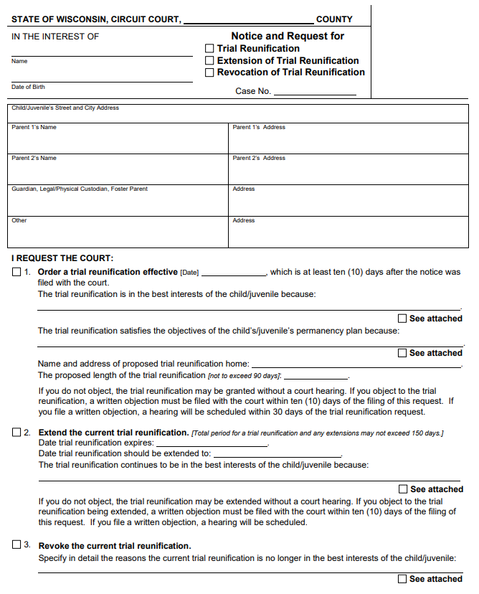
Trial Reunification
Child is placed with a parent on a trial basis
Ordered for up to 90 days
Only county agency can request
A party or caregiver can file an objection within 10 days to request a hearing
May be extended, but may not exceed 150 days total
Permanency planning continues occur during a trial reunification because the child/juvenile is still in an out-of-home placement status

Slide 39
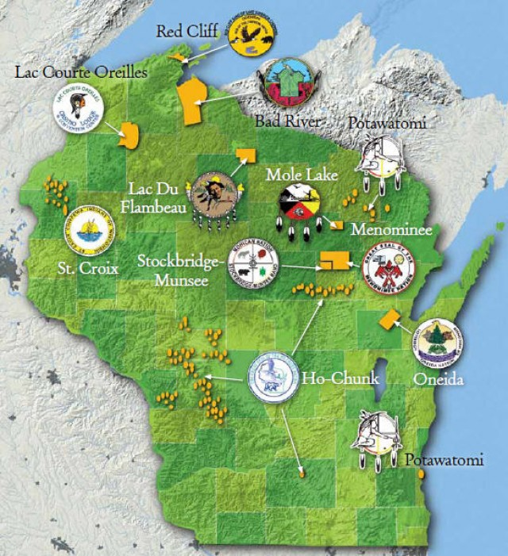
Wisconsin Indian Child Welfare Act

Slide 40
WICWA Reminders
Additional findings, notice, and procedures required when a CHIPS, JIPS, TPR, or guardianship case involves an “Indian child”:
Member of tribe, or
Eligible for membership and biological child of a member
WICWA specific circuit court forms available
See WICWA Judicial Checklist & E-Learning Activity: https://wicciptraining.com/

Slide 41
Rights of the Caregiver
Notice of all hearings in a CHIPS, JIPS, TPR, and delinquency case
Not given party status unless guardian or legal custodian
Right to object to a change in placement from caregiver’s home at any stage of the case
If objection filed within 10 days of sending notice, court will schedule a hearing
When child has been placed with relative for 6 months or more, additional notice requirements and right to appeal decision to remove the child, § 48.64
Right to be heard at all hearings by making a written or oral statement – §§ 48.27, 48.42, 938.27
https://dcf.wisconsin.gov/files/forms/doc/2474.docx

Slide 42
Rights of the Caregiver
CHIPS & JIPS cases: Guardian or Legal Custodian
Enter plea/contest the petition
Request jury trial and substitution of judge
Request change in placement, revision, or extension
File petitions:
TPR: Relative or guardian
JIPS: Relative or guardian
§ 48.977 Guardianship: Guardian, legal custodian, or current or recommended placement
§ 48.9795 Guardianship: Any person

Slide 43
Rights of the Caregiver
Guardian and legal custodian
Right to access Ch. 48 and Ch. 938 juvenile court records - §§ 48.396 & 938.396
Copies of court reports and permanency plans
Relative caregiver (without guardianship or legal custody) does not have right to access these records/documents unless:
Ordered by the court, or
Written permission provided by parent, guardian, legal custodian, or child (14 years or older)

Slide 44
Minor Guardianships
§48.977 - CHIPS Guardianships
§48.9795 - Minor Guardianships of the Person

Slide 45
Minor Guardianships
Minor Guardianship of the Person → Chapter 48
There are now 3 types of Chapter 48 Guardianships:
§ 48.977 – CHIPS Guardianships
§ 48.9795 – Minor Guardianships of the Person
Full, Limited, Temporary, and Emergency
§ 48.831 – Appointment of Guardian for Child Without a Living Parent
Minor Guardianship of the Estate → Chapter 54

Slide 46
Minor Guardianship Comparison Chart
Differences | § 48.977 | § 48.9795
Underlying CHIPS case for the child. | ✓
Child must live with guardian. | ✓
Subsidized guardianship payments permissible. | ✓
Procedure for appointing a successor guardian. | Subsidized only. | ✓
Annual report from guardian required. |  | Full only.
Court commissioner may conduct hearings. |  | ✓
Emergency guardianship available. |  | ✓

Slide 47
§ 48.977 – CHIPS Guardianships

Slide 48
§ 48.977 – CHIPS Guardianship Requirements
Child adjudicated CHIPS (or JIPS ground of uncontrollable behavior).
Child will live with proposed guardian.
Guardian willing and able to serve for an extended time or until child is 18.
TPR not in child’s best interests.
Parent is neglecting, refusing, or unable to fulfil the duties as guardian.
Agency has made reasonable efforts to prevent removal/return the child home.

Slide 49
§ 48.977 – CHIPS Guardianship Petition
Can be filed by:
Child
Parent
Guardian
Legal custodian or Indian custodian
Guardian ad litem
Nominated guardian
Department of Children and Families
Agency
District attorney/corporation counsel

Slide 50
§ 48.977 – CHIPS Guardianship Subsidized Payments
Monthly payments available for qualifying § 48.977 guardianships
County agency is responsible for determining eligibility. See § 48.623
If subsidized, the court must terminate/dismiss the underlying CHIPS case
If unsubsidized, the underlying CHIPS case will continue until terminated or order expires
Child and proposed guardian must be related or have a pre-existing relationship

Slide 51
§ 48.977 – CHIPS Guardianship Additional Considerations
Post-judgement matters include revision of orders, appointment of successor guardian, and termination
Termination: Child turns 18, guardian resigns, or court removes for cause
Parent can move to terminate if:
There is a substantial change in circumstances since guardianship order,
Parent is able to resume being guardian, and
Best interest of child to terminate guardianship
Permanency planning not required in guardianship case
It will continue as long as the CHIPS case remains open

Slide 52
§ 48.9795 – Minor Guardianships of the Person

Slide 53
§ 48.9795 Guardianship – 2019 WI Act 109
On August 1, 2020, Minor Guardianships of the Person moved from Chapter 54 to Chapter 48 and became §48.9795
Any previously ordered Chapter 54 minor guardianship of the person cases will be conducted under §48.9795 for any post-disposition activities (ex: modification, extension, appointing a successor guardian, resignation of guardian, etc.)
Minor Guardianships of the Estate remain in Chapter 54 and did not change
§48.977 CHIPS guardianships also did not change

Slide 54
§ 48.9795 Guardianship – GAL and Adversary Counsel
Guardian ad Litem
Guardian ad Litem must be appointed for the child
Report of the Guardian ad Litem (JN-1512) is available
Adversary Counsel
There is no requirement for appointing adversary counsel for a child
The court has the discretion to appoint counsel for the child of any age pursuant to § 48.23 (3)
SPD will appoint adversary counsel for a child over 12 when:
Request is made by the child or court or
SPD already represents the child in a Ch. 48 or 938 case

Slide 55
§ 48.9795 Guardianship – Types
Four types of minor guardianships of the person:
1) Full
2) Limited
3) Temporary
4) Emergency

Slide 56
§ 48.9795 Guardianship – Filing
Who may file? § 48.9795(4)
Anyone, including the child if age 12 or older; or
If the child/juvenile is subject to a CHIPS, UCHIPS, TPR, Delinquency, or JIPS:
Any party to that proceeding or anyone authorized by the court to file
Must be consistent with the permanency goals
May not change the requirements of any court order in the underlying case

Slide 57
§ 48.9795 Guardianship – Petition
Petition
JN-1501 / IW-1501 - Petition for Appointment of Guardian - Full/Limited/Temporary Guardianship
JN-1504 - Petition for Appointment of Emergency Guardian
Each petition requires a separate filing and own case number
§48.9795 does not have any language or a procedure to turn an Emergency Guardianship into a Full, Limited, or Temporary Guardianship

Slide 58
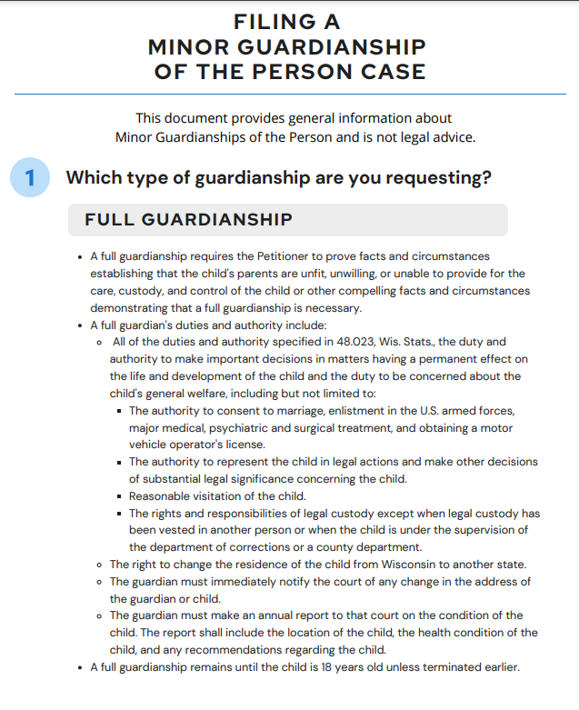
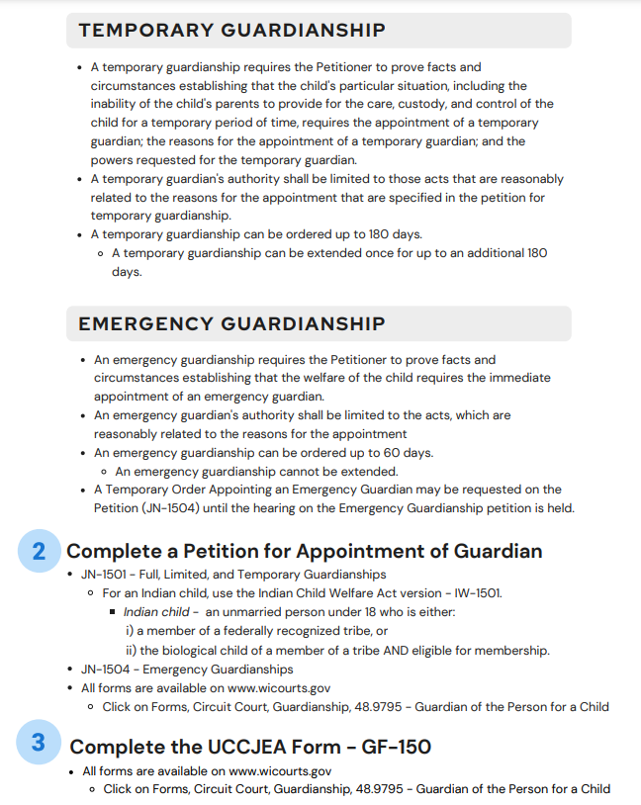
§ 48.9795 Guardianship – Filing Guide

Slide 59
§ 48.9795 Full Guardianship
All of the duties and authority under § 48.023
Authority to determine reasonable visitation
Right to change the residence of the child from one state to another state
Duty to immediately notify the court of any change of address
Required to file an annual report regarding the condition of the child (Circuit Court form JN-1550)

Slide 60
§ 48.9795 Limited Guardianship
Limits the duties and authority of a full guardianship
The child’s parents need assistance in providing for the care, custody, and control of the child
Requires an expiration date
Limited guardianships can be extended
An Annual Report of the Child may be required to be filed at the discretion of the court
Examples:
Child moves out of state to live with a relative, parent is incarcerated for a few years, military service deployment
Can be used for private TPRs until the adoption is finalized
Guardian may be given healthcare and/or school authorities
Notes:
Limit duties and authorities to healthcare and school.

Slide 61
§ 48.9795 Temporary Guardianship
Guardian’s authority shall be limited to those acts that are reasonably related to the reasons for the appointment that are specified in the petition for temporary guardianship
Temporary guardianship cannot exceed 180 days
One-time extension up to an additional 180 days
Authority is given to someone for a shorter period of time
Examples: a parent’s health condition, upcoming surgery and long recovery, short incarceration sentence

Slide 62
§ 48.9795 Emergency Guardianship
Petitioner must demonstrate that the welfare of the child requires the immediate appointment of an emergency guardian
Emergency guardianships cannot exceed 60 days and cannot be extended
Examples: medical consent when a parent is unavailable, parent may remove child from a proposed guardian’s care, or other circumstances necessitating an immediate guardian for less than 60 days

Slide 63
§ 48.9795 Guardianship – Timelines
Initial Hearing for a full, limited, or temporary guardianship must be held within 45 days of the petition being filed
An emergency guardianship should be heard as soon as possible
Fact-Finding Hearing OR Fact-Finding and Dispositional Hearing must be heard within 30 days of the Initial Hearing.
Standard: Clear and convincing evidence
Hearings can be adjourned for good cause under § 48.315

Slide 64
Key Provisions of §48.9795
Letters of Guardianship and Dispositional Order Appointing Guardian are combined into one form for § 48.9795 guardianships
The court can order:
Reasonable rules of parental visitation
Amount of support to be paid by the child’s parent(s)
The amount of support is not child support
Successor guardian
Annual Reports
Full Guardianship – required to be filed annually
Limited – may be required to be filed at the discretion of the court
Temporary and Emergency – not required by statute

Slide 65
Key Provisions of §48.9795
There are clear procedures and forms for the following post-dispositional activities:
Review of Conduct of Guardian
Request to Modify
Request to Extend
Request to Terminate
None of these guardianship orders can change the placement of a child under the supervision of the court in another Ch. 48 or Ch. 938 case

Slide 66
Circuit Court Forms www.wicourts.gov
Hover over Forms and select Circuit court
Select Guardianship
If Indian child, use ICWA forms for additional findings & notice requirements

Slide 67
Minor Estate Guardianships & Minor Person
The court may consolidate a newly filed minor estate and §48.9795 minor person guardianship case
If the court consolidates the two cases, there will be only one case number: 21 JG ___
Consolidation is not required
The court may keep the two cases separate with two case numbers and schedule both cases at the same time

Slide 69
Contact information
Bridget Mauerman
Director, CCIP
Phone: (608) 267-1958
Email: bridget.Mauerman@wicourts.gov
Kristen Wetzel
Legal Advisor, CCIP
Phone: (608) 264-6905
Email: kristen.wetzel@wicourts.gov

