Slide 1
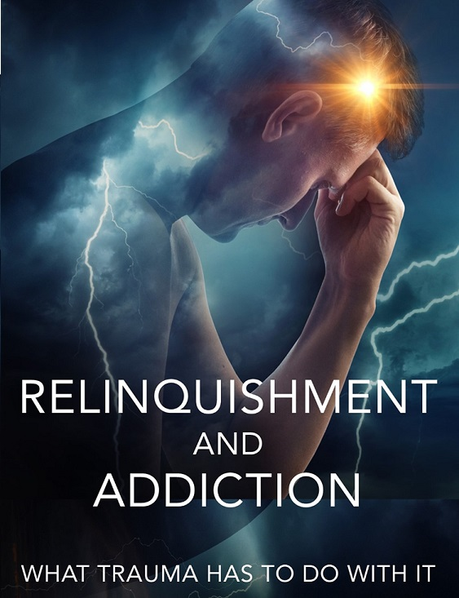
The Complexities of Addiction –
Implications for Foster Care and Adoption Constellation Members
David B. Bohl, MA, CSAC, MAC
June 3, 2023

Slide 2
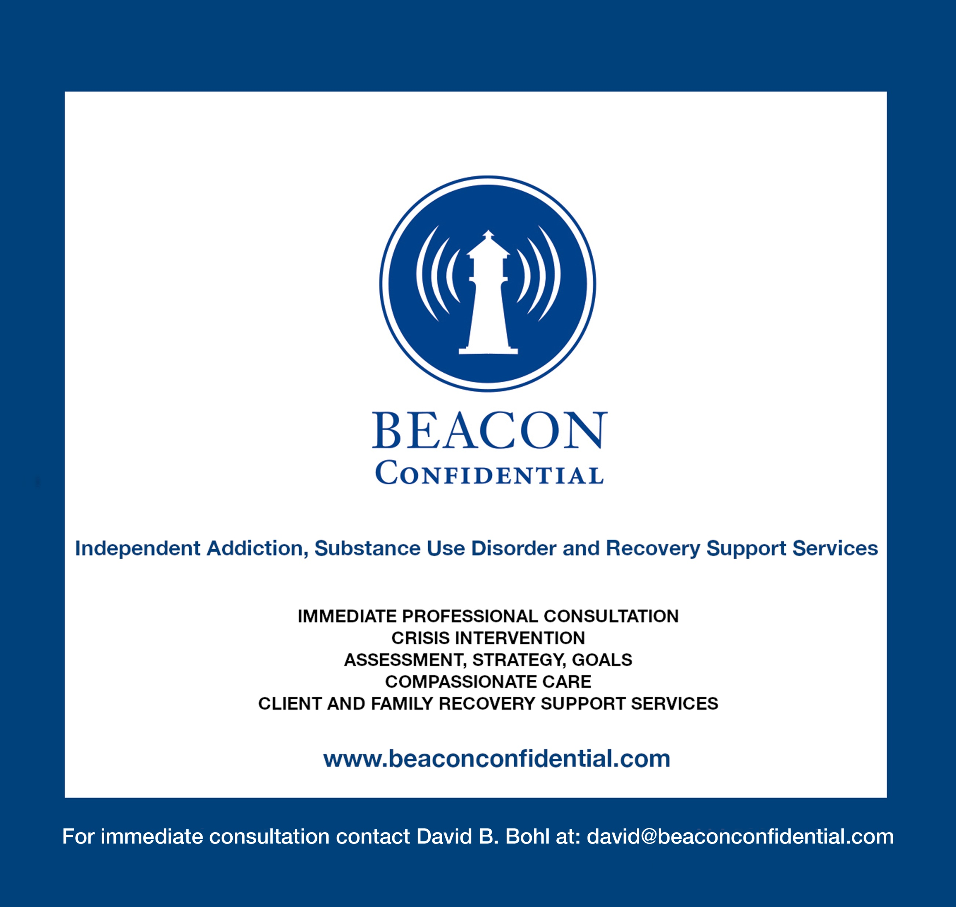
Professional and Personal Experience

Slide 3
Today’s Learning Objectives
Substance abuse’s effects on families.
Experiences specific to relative caregivers. And hopefully we’ll validate your experiences.
How relative caregivers can take care of themselves.
How some of the children in your care may be feeling and how to best support and have conversations with them.
Specific resources for supporting you and those in your care.

Slide 4
Relative Caregiver Stress
Confusion
Misunderstanding
Worry
Anger
Depression
Shame
Guilt
Anxiety
Behavioral problems
Financial pressure
Health-related issues
Housing challenges
Education concerns
Work issues
Resentment at being put in the position to have to sacrifice and take care of children they did not plan to be raising.

Slide 5
Substance use and addiction impact families in different ways
Children:
Risk for anxiety, depression, and behavior and cognitive difficulties.
Higher risk of experiencing Adverse Childhood Experiences (ACEs) such as abuse and neglect.
More likely to be placed in foster homes.
Higher risk to develop addiction later in life.
Families:
Marital disintegration, violence, conflict, child neglect, and legal issues.
Unmet needs, impaired attachments, economic hardships, emotional distress, violence
Stress and crisis can impede the family’s functioning.
Creates circumstances that can lead to physical and physiological ill-health.

Slide 6
Adverse Childhood Experiences (ACEs) - Risk factors
Potentially traumatic events that occur in childhood
Positive Childhood Experiences (PCEs) – Protective factors
Buffering relationships that reduce stress and build resilience
Talk with family about feelings.
Feels family is supportive during difficult times.
Enjoys community traditions.
Feels like she/he belongs in school.
Feels supported by friends.
Has two+ non-parent adults who genuinely care.
Feels safe and protected by adult in home.

Slide 7
Three major themes emerge in families when dealing with a relative with a SUD:
Grieving the lost – the loss of a relationship/ family member
Living in dread and despair – daily fear and sense of helplessness, and
Living in perpetual crisis – causing physical and mental exhaustion.

Slide 9
THERE IS HOPE: Families do take action
Look for resources to help them make sense of their experiences and provide options for dealing with their heartaches.
Become familiar with support groups.
Seek online information and social media discussions on addiction.
Work with individuals such as myself or therapists to sort through the complexities of substance use and its effects on families.

Slide 10
Daily Self-Care Plan
Diet
Sleep
Exercise
Proper medical care
Learning/ Flow
Connection

Slide 11
Boundaries
The purpose of boundaries is not to punish or manipulate
your loved one into changing.
The purpose of boundaries is to live by your values and
to separate yourself from unhealthy enmeshments.
ULTIMATE BOUNDARY SHOULD BE AS FOLLOWS:
You need to be ok no matter what happens.

Slide 12
Where to Start – Specific Boundaries
I will not allow myself to be hurt/ unsafe.
I will have a safety plan.
I will not enable unhealthy behavior(s).

Slide 13
Non-Negotiable Boundaries
Physical violence (hitting, pushing, shoving, holding you down, pinning you).
Blocking exit.
Extreme jealousy.
Needing to know whereabouts all the time.
Needing you to check in numerous times.
Isolating you from friends and family.
Degrading and shaming comments.
Intimidation.
Sexual violence (rape, coercion, pressure).

Slide 14
Potentially Negotiable Boundaries
I loan money to my Loved One (LO), but often do not get repaid. *
I am supporting someone financially who should be able to support him/herself. *
My LO lies to me, covers up the truth of his/her activities. *
I fail to speak up when I am being treated poorly. *
I frequently agree to do things in order to keep the peace or to please others. *
My LO has been responsible for causing damage to, or theft of, my property. *
I give and give and give in this relationship — and in return, I get less and less and less. *
I don’t give any thought to my own happiness. **
My LO sometimes disappears for long periods of time without making contact. *
I frequently feel angry in response to my LO’s behaviors. *
I feel like I can’t make plans because my LO is so unpredictable. *
I can only be happy if my LO is doing well. Otherwise I’m anxious.**
My LO is emotionally unavailable much or all of the time.*
My LO does not accept responsibility for any household chores. *
I don’t feel like I’m thriving, only surviving.**
My LO expects me to be a backup alarm for work/school if he/she oversleeps. *
My LO doesn’t clean up after him/herself. *
My LO does not follow through on promises. *

Slide 15
Communicating Boundaries
“No.”
“I’m not comfortable with this.”
“Please don’t do that.”
“Not at this time.”
“I can’t do that for you.”
“This doesn’t work for me.”
“I’ve decided not to.”
“This is not acceptable.”
“I’m drawing the line at ___.”
“I don’t want to do that.”

Slide 16
Assertiveness Formula
I feel __ (scared, anxious, angry, invisible)
when you___ (come home drunk)
because _____ (it’s dangerous to yourself and your children)
I need __ (for us to get help with this)

Slide 17
Community Reinforcement and Family Training (CRAFT)
Learn how to nudge loved one away from substance abuse and related behaviors.
Modify the family member’s behavior in such a way that a non-substance using lifestyle is more rewarding than one focused on using alcohol or other drugs.

Slide 18
Positive Reinforcement
Helps loved ones prioritize their mental health and improve their happiness.
Reward their loved one when they choose sobriety or show control.
Allow consequences to naturally accrue.

Slide 19
Here are 10 helpful messages about CRAFT
Family members can learn to engage their loved ones.
You are not alone.
Easier to get your loved one to listen to loving words than to criticism.
People can be helped at any time.
You can live a happier life whether or not your loved one becomes healthy.
When you help yourself, you help your family.
Neither you nor your loved one are crazy.
Most problems vary in degree and difficulty.
Calling someone an “Addict” or “Alcoholic” doesn't help.
You have nothing to lose and a lot to gain by getting involved.

Slide 20
CRAFT method encourages these practices
When is loved one most tempted to use?
Communicate more clearly.
Use positive reinforcement consistently.
Let loved one face the consequences that accrue.
Learn when to act on willingness.
Support loved one through therapy.

Slide 21
Adapt Negative Feelings to Positive Statements
Negative: You always mess things up when you come home.
Positive: I enjoy you so much when you don't drink/use.
Negative: You always embarrass me.
Positive: It would make me so happy if you drank soda tonight.
Negative: I'm not having intimate relations with you when you're drunk.
Positive: I'd enjoy intimacy with you when you're sober.
Negative: I can't stand it when you lie to me. All you ever do is tell stories full of lies.
Positive: I want to believe you, but that story seems odd.
Negative: You never listen to me when I'm talking to you.
Positive: I understand that some of our discussions are upsetting, but I'd love it if you could help me work them out.
Negative: Don't ever let me catch you yelling at the kids like that again.
Positive: I know the kids can be frustrating, but please help me set a good example by talking to them calmly.

Slide 22
What can you do today – starting right now?
Practice communicating boundaries, including Assertiveness Formula.
Start turning negative feelings and statements into positive moments of communication.
Read the book Get Your Loved One Sober: Alternatives to Nagging, Pleading, and Threatening.
Find a CRAFT Certified therapist.
Find a family coach.

Slide 23
What can we do to better support those in our care?
Learn how to have a conversation about addiction
Amanda, age 15, understands today that she was adopted because both of her birth parents were alcoholic and unable to care for her. When Amanda was a preschooler, her adoptive parents explained to her that her birth parents could not take care of her because they were not healthy and were unable to meet the responsibilities of parenthood. As Amanda reached the school-age years, she understood that she was removed from her parents’ care by child protective social workers because her parents did not care for her properly. As a middle school child, Amanda learned about the disease of alcoholism and the history of her parents’ ongoing struggle with sobriety. As an adolescent, Amanda is learning that her grandparents were also alcoholic. She is being taught about the genetic predisposition to this disease, and her parents are helping her learn strategies to avoid a future of alcohol abuse for herself.

Slide 24
What can we do to better support those in our care?
Remember what you’re responsible for and what you’re not responsible for.
The 3 C's – discussed in family support groups say:
I didn't Cause it
I can't Cure it
I can't Control it
The only thing I can control is myself and my actions and reactions.
I can't worry myself into peace of mind, either.

Slide 25
What can we do to better support those in our care?
Attend support groups focused on substance use
Al-Anon - Family and friends of those addicted to alcohol.
Alateen - Division of Al-Anon for adolescens.
Nar-Anon - Family members and loved ones of those who addicted to drugs.
Families Anonymous – Relatives and friends concerned about the use of drugs.
GRASP - Grief Recovery After Substance Passing is for people who have lost a loved one.
NAMI - The National Alliance on Mental Illness (NAMI) many support options for loved ones.
PAL - Parents of Addicted Loved Ones -Christian group of parents helping other parents.
SMART Recovery Family & Friends - Alternative to Al-Anon using CRAFT methods.

Slide 26
What can we do to better support those in our care?
Seek counseling and/or coaching
Overall support
Source of knowledge on ways to cope with caregiver fatigue
Helps both children and caregivers make sense of the complexities that addiction causes

Slide 27
What can we do to better support those in our care?
Have regular conversations about addiction with the children in your care
Offer safety.
Be a good listener.
Remind them that they are not responsible for the problem in the family.
Help them to identify feelings, encourage them to talk about uncomfortable feelings.

Slide 28
Review
We talked about substance abuse’s effects on families.
We’ve validated your experiences as relative caregivers.
We’ve given you a plan to take care of yourselves.
We’ve talked about how some of the children in your care may be feeling and how to best support and have conversations with them.
Finally, we’ve offered specific resources for supporting you and those in your care.

Slide 29
“I have come to believe that caring for myself is not self-indulgent. Caring for myself is an act of survival.”
– Audre Lorde
___________________________________
The Complexities of Addiction –
Implications for Foster Care and Adoption Constellation Members
David B Bohl, MA, CSAC, MAC
David@DavidBBohl.com
https://davidbbohl.com/
http://beaconconfidential.com/

Slide 30
Wisconsin Adoption and Permanency Support presentation
On Adoption and Addiction Recorded Webinar
https://www.eventbrite.com/e/recorded-webinar-on-adoption-and-addiction-registration-146172358459

Slide 31
SUPPORT GROUP RESOURCES FOR ADOPTEES STRUGGLING WITH ADDICTION
Addiction and Adoption Support Group– virtual support group - facilitated
https://celiacenter.org/events/addiction-and-adoption-constellation-support-group-tuesday-january-10th-2023/
Adoption & Addiction – virtual support group – peer led
https://www.adopteesandaddiction.com/
Dual Recovery Anonymous - DRA has two requirements for membership; a desire to stop using alcohol and other intoxicating drugs and a desire to manage our emotional or psychiatric illness in a healthy and constructive way. http://draonline.org/
Adult Children of Alcoholics - program of people who grew up in dysfunctional homes. Many say that The Laundry List – 14 Traits of an Adult Child of an Alcoholic – describes the relinquishment trauma
experience very accurately/ https://adultchildren.org/

Slide 32
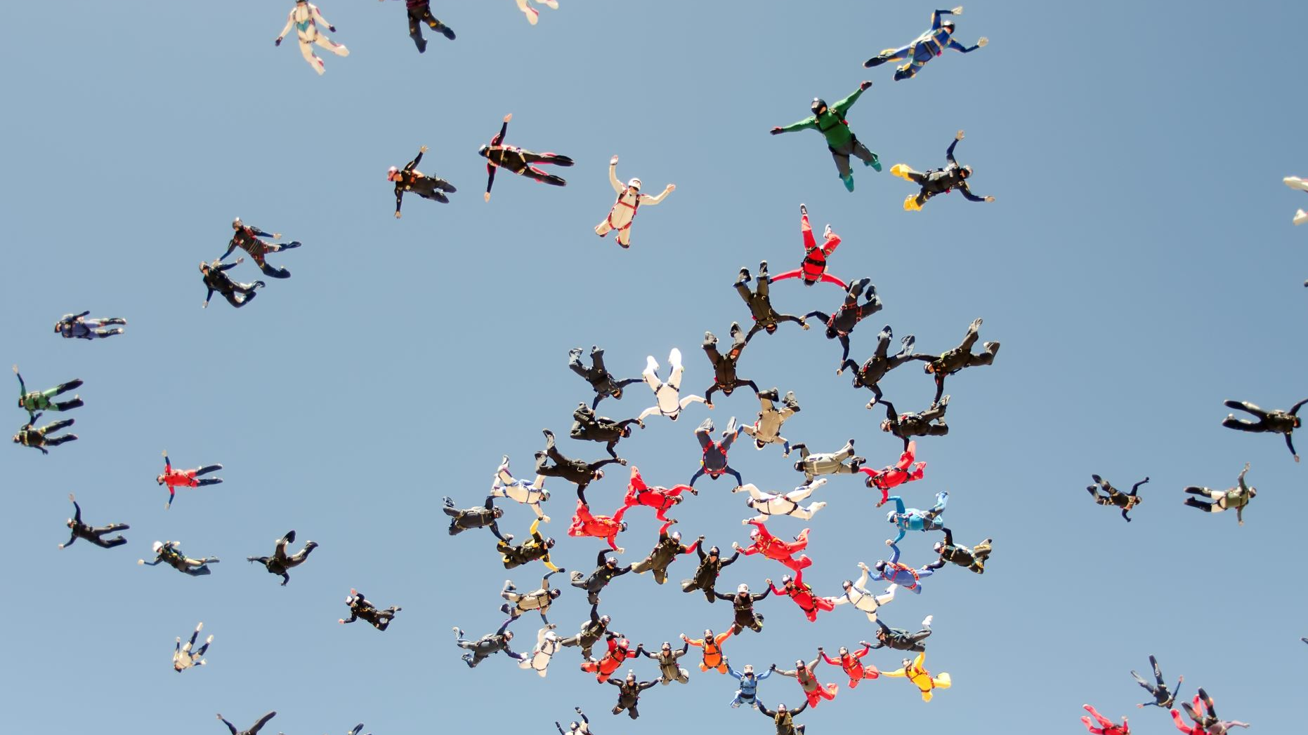
Resources
"I can't live like that": the experience of caregiver stress of caring for a relative with substance use disorder https://pubmed.ncbi.nlm.nih.gov/33446208/
Grandparent and Relative Caregiver Resources https://wisconsincaregiver.org/grandparenting-resources
Support Groups
This WISAPS Relative Caregiver Group https://wisapsp.org/virtual-support-groups/
Addiction and Adoption Constellation Support Group:
https://celiacenter.org/events-calendar-support-groups/
Al-anon Family Groups: https://al-anon.org/
Alateen: https://al-anon.org/for-members/group-resources/alateen/
Families Anonymous: https://www.addictiongroup.org/resources/families-anonymous/
Naranon: https://www.nar-anon.org/
GRASP - Grief Recovery After Substance Passing: http://grasphelp.org/about-us/
NAMI – National Alliance on Mental Illness https://www.nami.org/Home
PAL - Parents of Addicted Loved Ones: https://palgroup.org/
SMART Recovery Family & Friends: https://www.smartrecovery.org/family/
Education
Social Unity: The Restorative Powers of Community and Support Systems,
( https://davidbbohl.com/restorative-powers/)
Report: Taking Care of Yourself While Raising Your Grandchildren
https://www.retireguide.com/guides/self-care-raising-grandchildren/
Your Choice https://www.yourchoiceprevention.org/webinars
SAMHSA: Families Supporting a Loved One https://www.samhsa.gov/families
SAMHSA: Helping a Loved One Dealing with Mental and/or Substance Use Disorders
SAMHSA: Supporting a Loved One Dealing with Mental and/or Substance Use Disorders
Book: Get Your Loved One Sober: Alternatives to Nagging, Pleading, and Threatening
https://www.amazon.com/Get-Your-Loved-One-Sober/dp/1592850812
Book: Relinquishment and Addiction: What Trauma has to Do with It
https://davidbbohl.com/relinquishment-and-addiction/
Report: Boundaries in Addiction Recovery
https://www.hazeldenbettyford.org/articles/boundaries-in-addiction-recovery
Preventing, Identifying, and Treating Substance Use Among Youth in Foster Care
SAMHSA (Substance Abuse and Mental Health Services Administration)
Resources for Families Coping with Mental and Substance Use Disorders
https://www.samhsa.gov/families

Slide 34
“I have come to believe that caring for myself is not self-indulgent. Caring for myself is an act of survival.”
– Audre Lorde
___________________________________
The Complexities of Addiction –
Implications for Foster Care and Adoption Constellation Members
David B Bohl, MA, CSAC, MAC
David@DavidBBohl.com
https://davidbbohl.com/
http://beaconconfidential.com/

